Slide 1

Collaboration With Jupyter Notebooks
Data Science Symposium 2022
University of Cincinnati
Center for Business Analytics
Notes:
G

Slide 2
Collaboration With Jupyter Notebooks
Data Science Symposium 2022
University of Cincinnati
Center for Business Analytics
Art by DALL-E 2 on labs.openai.com

Slide 3


Slide 4

Dammit Jim, I'm data scientist not an MLOps

Slide 5
Finding Things
Slides: github.com/jgunderson/presentations
Stories: jeffrey-p-gunderson.medium.com
E-mail: jeff@bidiscover.com

Slide 6
Collaboration is Critical
Studies show only 13% of data science models make it to production (VentureBeat)
Effective collaboration is a major issue:
Disconnect between the data science team and the stakeholders
Difficulty of sharing and communicating within the team

Slide 7
Collaborative Software for Data Science
Multi-user access
User authentication
Sharing work products
Shared, standard environments
Sharing status and changes
Documenting and presenting results
Notes:
Collaborative software provides your team and stakeholders with a central platform to share knowledge and deliverables to complete projects.
* multi-user access – avoids everyone installing and setting up tools.
* list
As you know, software is not the complete answer to collaboration. A team culture that encourages sharing and transparency is important. But good software can facilitate.

Slide 8
Collaborative Platforms
Binder - based on open source Binder. Uses GitHub and Docker containers. Free service at mybinder.org.
Google Colaboratory - sharing based on Google Drive or GitHub. Free service at colab.research.google.com
Cocalc - commercial service oriented to academics and course management. Cocalc.com
Kraggle - oriented to education, for internal use only (non-commercial). Free service at Kraggle.com

Slide 9
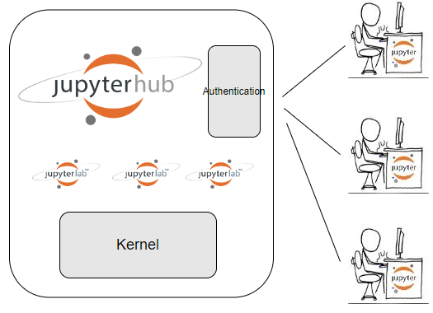
JupyterHub/JupyterLab

Slide 10
Installing JupyterHub
JupyterHub installation: jupyterhub.readthedocs.io
The Littlest JupyterHub: tljh.jupyter.org
JupyterHub can be installed on a Linux/Unix server or virtual machine

Slide 11
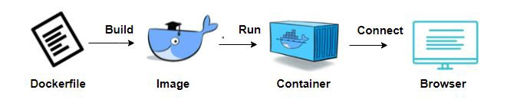
Installing JupyterHub in a Container
Rather than spinning up an entire virtual machine, Docker containers are small, fast, and portable.
Notes:
Container technologies have a number of advantages over VM. Container virtualization is simpler than virtual machines (doesn't simulate all hardware and control multiple OS's) Containers are easy to configure and deploy. They have a smaller footprint. And easy to extend. Docker is the most popular. You define an image in a Dockerfile, run a build command. You can then start and instance of the image in a container. And then connect to the container with a browser.

Slide 12
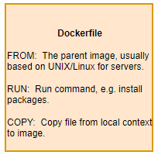
Building a Docker Image
Images are easy to build and extend.
FROM continuumio/miniconda3:latest
RUN conda install -c conda-forge
jupyterhub \
jupyterlab-drawio
COPY jupyterhub_config.py

Slide 13

Docker Hub
Repository service where you can push and pull Docker container Images.
Docker Hub Quickstart Documentation
Photo by Ian Taylor on Unsplash

Slide 14
JupyterHub for Collaboration Image
Anaconda
JupyterHub/JupyterLab
JupyterLab Git
Support for reveal.js
JupyterLab Table of Contents support
Interactive Matplotlib support
Support for adding new users
Image on hub.docker.com:
JupyterHub4Collaboration
Stories on medium.com:
Data Science Team Collaboration with JupyterHub and JupyterLab

Slide 15
Deploy the Image from Docker Hub
Install Docker (see docs.docker.com)
Using a terminal or PowerShell pull the image from Docker Hub and run the image in a container named j4c using:
Connect: http//localhost:8000
docker run -p 8000:8000 -d --name j4c / jeffgunderson/jupyterhub4collaboration

Slide 16
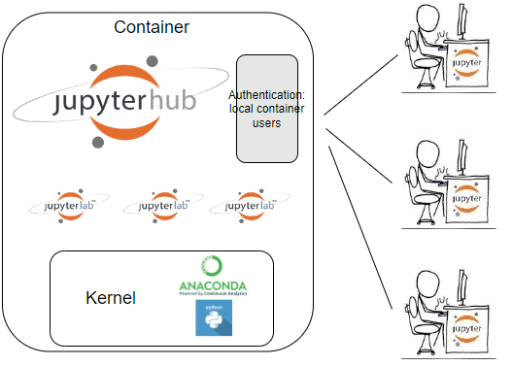
JupyterHub for Collaboration

Slide 17
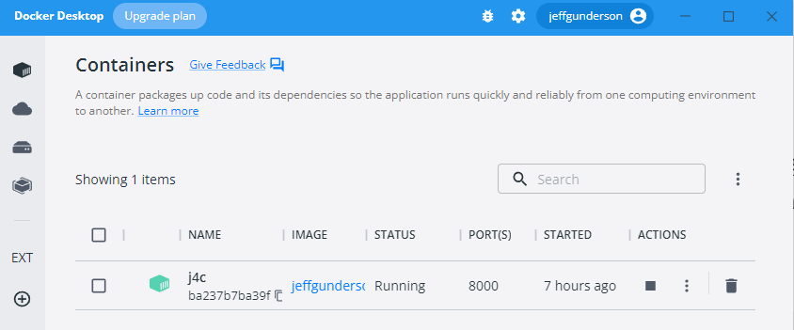
Demo: Docker Desktop
Docker Desktop displays images and containers. Actions are provide to control containers and view logs. You can also view volumes. Volumes allow you to persist data on the host machine file system

Slide 18
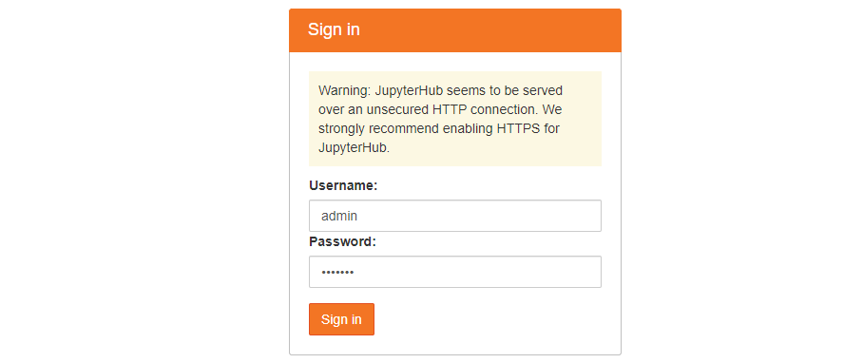
Demo: Connect to Hub
Sign on to http://localhost:8000. In the docker file for this image we run commands to define an “admin” user with password “default”.

Slide 19
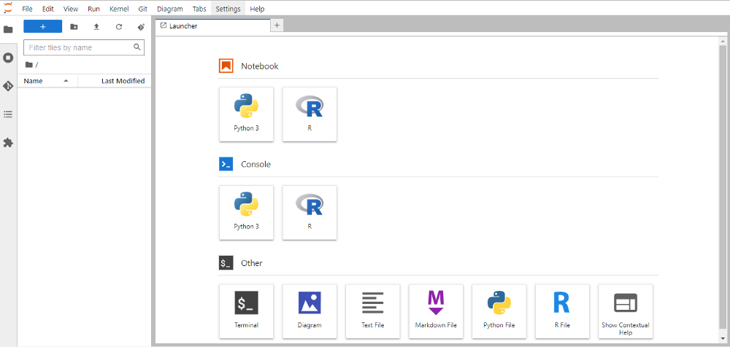
Demo: JupyterLab Launcher
This will present the JupyterLab Launcher where you can launch notebooks, consoles and other applications.

Slide 20
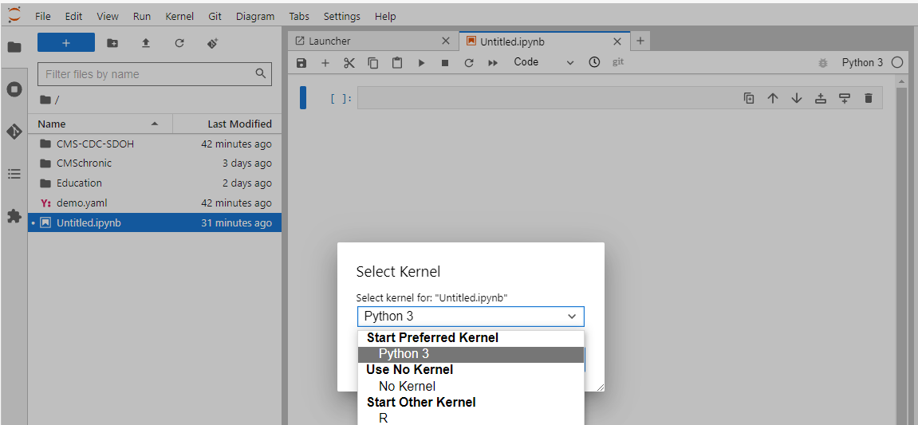
Demo: Environments
To list environments, open a notebook and select Kernel > Change Kernel

Slide 21
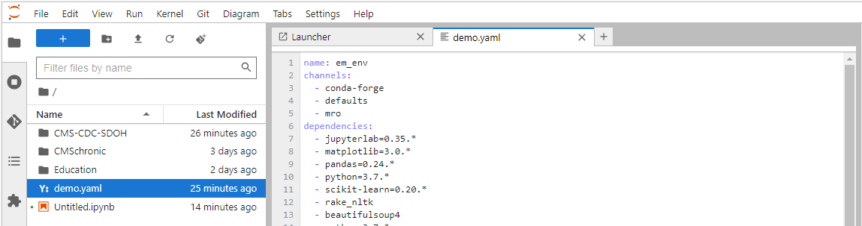
Demo: Defining New Environment
You define environments through yaml files. The yaml file defines: name of environment, channels (locations of packages) dependencies (packages to install). See demo.yaml file. For more detail on using conda with JupyterHub see: A quick guide to conda environments on JupyterHub.

Slide 22
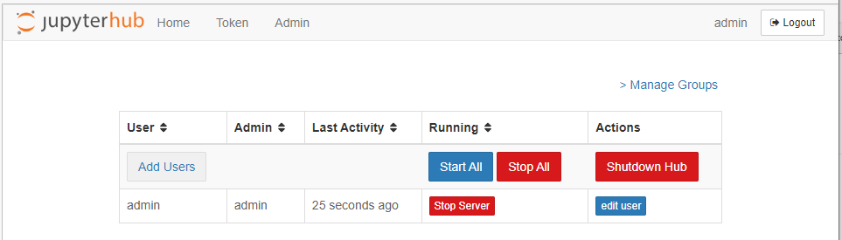
Demo: Add User
JupyterHub supports a number of user authentication methods. We are using the default PAM-based Authenticator, for logging in with container user accounts via a username and password. To add a new user select File > Hub Control Panel > Admin: For production look at using GitHub’s OAuth so that you will be delegating to GitHub authentication. If you are providing this on a public network then you can use SSL or a VPN. Instructions for SSL are provided in the Medium stories.

Slide 23
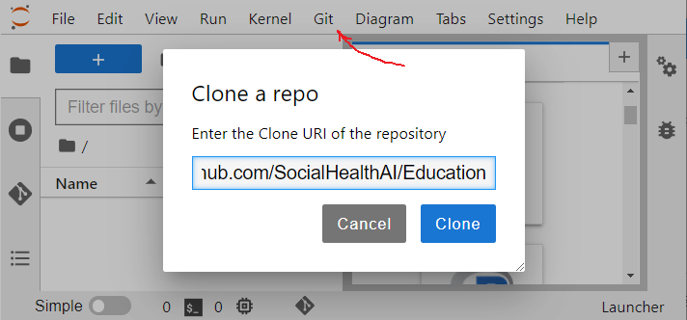
Demo: GitHub
To manage sharing files with the team, GitHub provides a central repository and allows you to track changes across versions. You can use a public repository to evaluate the extension like SocialHealthAI/Education. Or to set up a repository see: Create a repo — GitHub Docs. For authentication you will need to set up a personal access token – see Personal access tokens. Note that authentication is not necessary if you just want to clone a public repository.

Slide 24
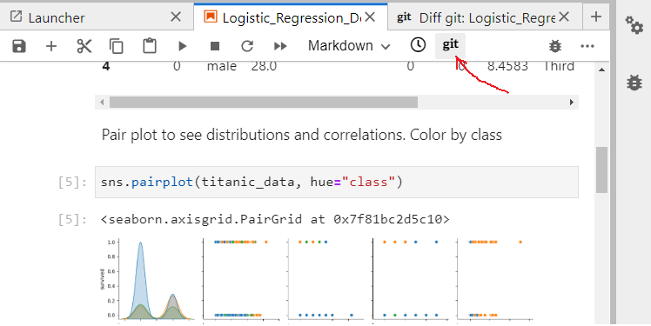
Demo: Git Diff View
To review changes to your notebooks use the git Diff view

Slide 25
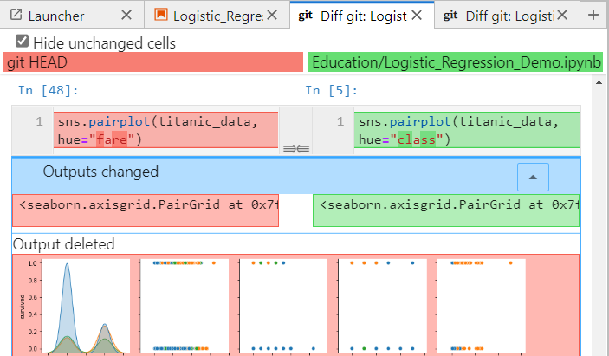
Demo: Git Diff : Input/Outputs
The Diff git view shows changes to the code and markdown cells. And it shows outputs deleted and added. If you were to review changes with another diff tool or changes using the GitHub site they would not very useful as notebooks are json files. The GitHub extension for JupyterLab shows changes to the cell contents and the new outputs instead of showing changes to the json file. So you can easily review your updates before committing them to GitHub and share them with the team.

Slide 26
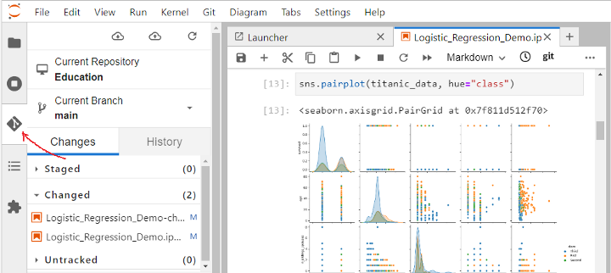
Demo: Git Changes
Selecting the git icon on the left, you can review your staged, changed and untracked files. You can then stage the changed files, commit them and push to GitHub to share with your team.

Slide 27
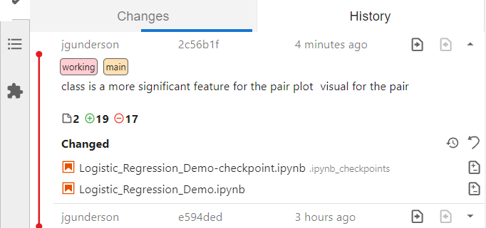
Demo: Git History
If you select the History panel you review the changes in each push to the repository and each branch. You can see the detail and reasons behind the changes made by your team members.

Slide 28
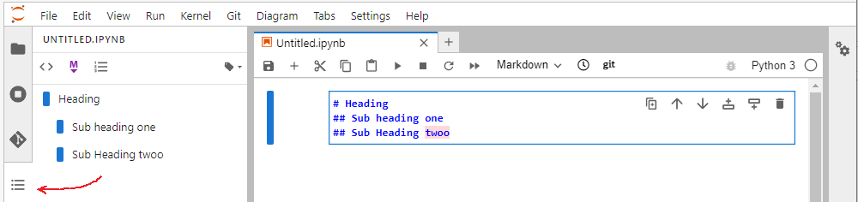
Demo: Table of Contents
Let's now at presenting results. JupyterLab Table of Contents is a great way to show the structure of your notebooks and to help navigate. The markdown heading structure is used to present a table of contents. And you can choose to have headings numbered. To navigate to sections in your notebook, select the TOC heading. Note that we installed the JupyterLab Spell Checker and it highlighted a mistake.

Slide 29
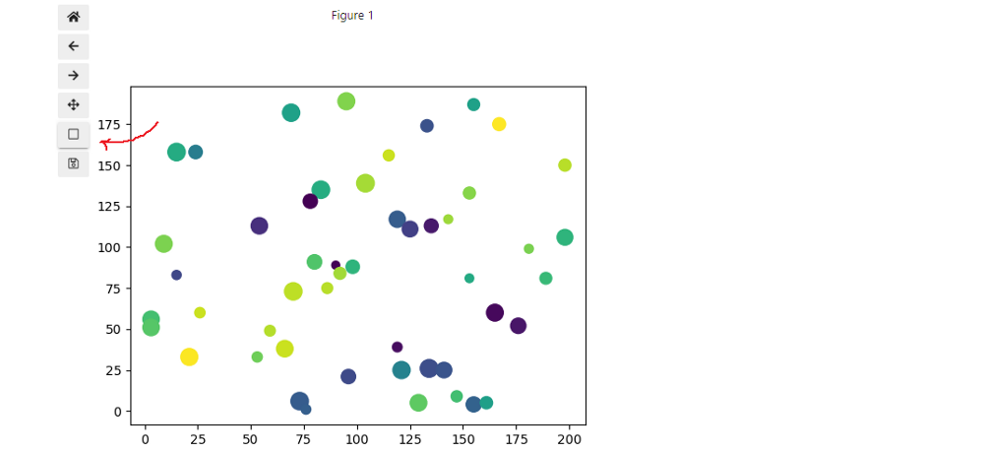
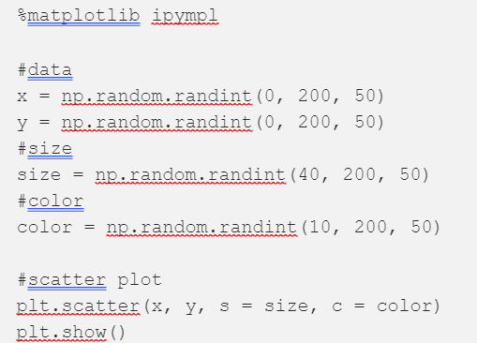
Demo: Interactive Plots
Matplotlib is a popular library for creating static, animated, and interactive visualizations in Python. To help you present Matplotlib charts, the ipympl extension provides interactive features. All you need to do is include the %matplotlib ipympl magic in the notebook. The extension provides selections to pan and zoom into charts

Slide 30
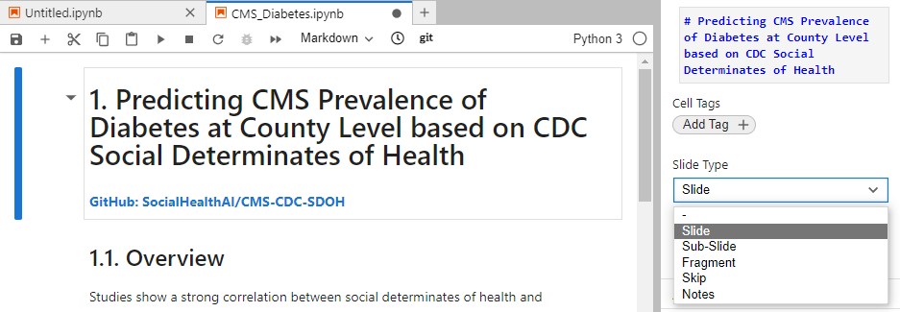
Demo: Presentation Slides
You can create presentation slides from JupyterLab notebooks using the reveal.js extension. Reveal.js is a popular open source HTML presentation package. To create a presentation, open the right sidebar using View > Open Right Sidebar. For each cell, add a slide tag to determine how to present the cell.

Slide 31

Demo: Presentation Slides
Then export the notebook using File > Save and Export Notebook As > Reveal.js Slides. This exports an html file which uses the reveal.js javascript libraries to render slides. To view the file you will need to install the reveal.js libraries . The slides provide selections to show the next, previous or sub-slides. You can also export reveal.js slides to a PDF. Browser print to PDF produces a pretty PDF.

Slide 32

Thank You
Try the image on hub.docker.com: JupyterHub4Collaboration
Let me know your ideas, suggestions, issues.
You can also get help at discourse.jupyter.org
If you are in interested in AI for Good:
AI for Good Foundation: ai4good.org
Delta Analytics: deltanalytics.org
Jeff Gunderson
Jeff@bidiscover.com
Business Card

